Slide 1
How to Read a Book
TM: Mark
Date: July 24th, 2021

Slide 2

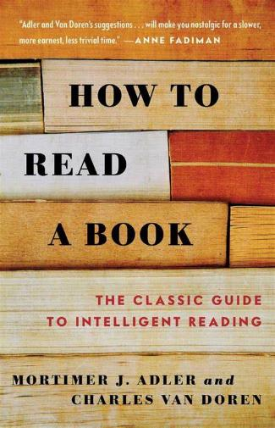
How to Read a Book

Slide 3
Why we read a book?
Just for fun.
Reading for information.
Reading for understanding.
Solving the problem we meet in our life.(My View)

Slide 4
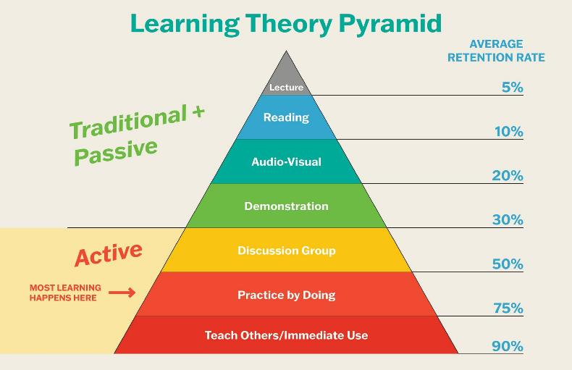
How to Learn
- Learn by doing
- Learn by teaching
- Learn by sharing

Slide 5
The levels of reading
Level 4
Syntopical Reading
主题阅读
Level 3
Analytical Reading
分析阅读
Level 2
Inspectional Reading
检视阅读(略读、泛读)
Level 1
Elementary Reading
基础阅读

Slide 6
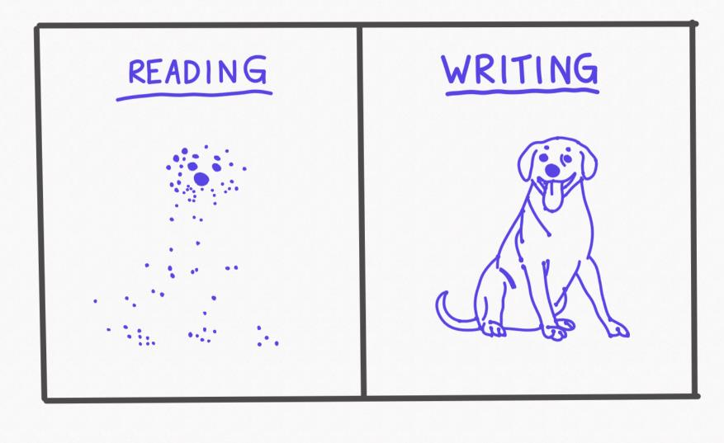
Reading vs. Writing

Slide 7
Classic sentence I think
The child is a natural questioner. how to read philosophy
The ability to retain the child’s view of the world, with at the same time a mature understanding of what it means to retain it, is extremely rare—and a person who has these qualities is likely to be able to contribute something really important to our thinking. how to read philosophy
But we must be able to see as children see, to wonder as they wonder, to ask as they ask. The complexities of adult life get in the way of the truth. The great philosophers have always been able to clear away the complexities and see simple distinctions—simple once they are stated, vastly difficult before. If we are to follow them we too must be childishly simple in our questions—and maturely wise in our replies. how to read philosophy

Slide 8
Thank you!

